Slide 1
Power BI All-In-One
By Lokesh Lalwani

Slide 2
Business Intelligence (BI) Concepts

Slide 3
BI Tools
Microsoft Power BI
Tableau
Sisense
Looker
datapine
Zoho Analytics
Yellowfin
Answer Dock
Hotjar
ReportPlus
QlikView
SAP BusinessObjects Lumira
SAP Crystal Reports
SAP Business Intelligence
Vista
Clootrack

Slide 4
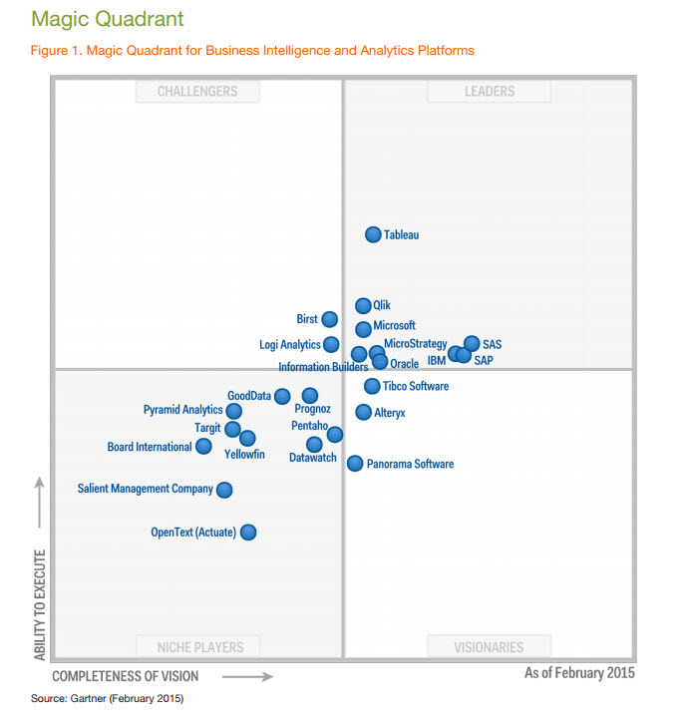

Slide 5
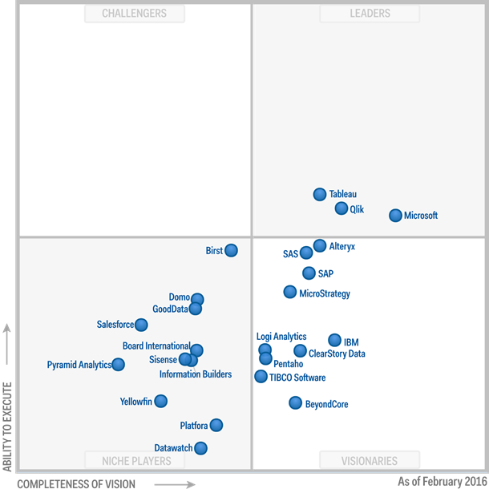

Slide 6
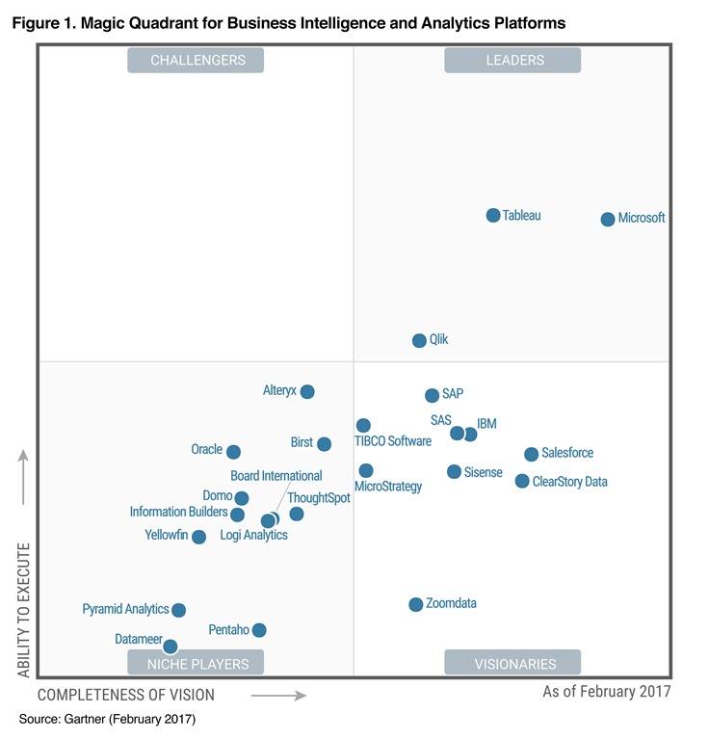

Slide 7
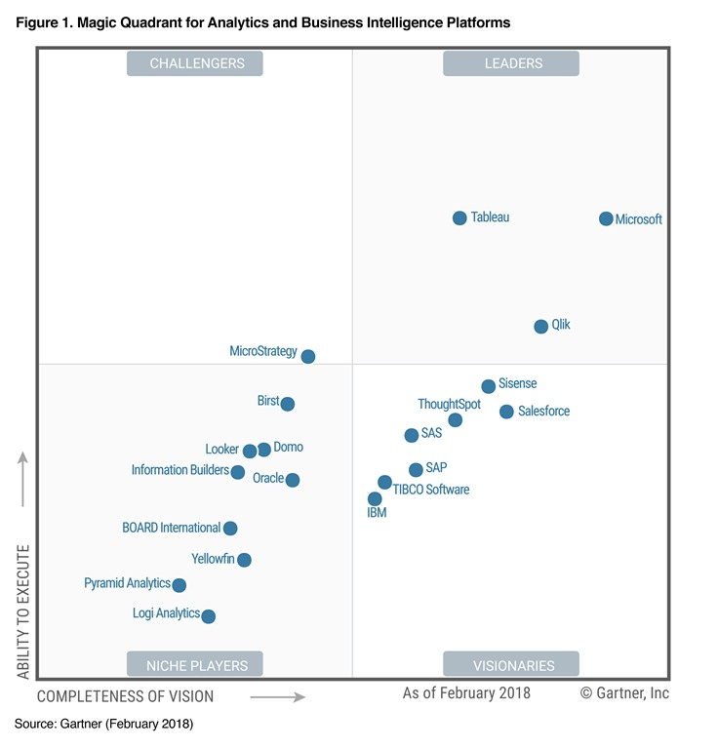

Slide 8
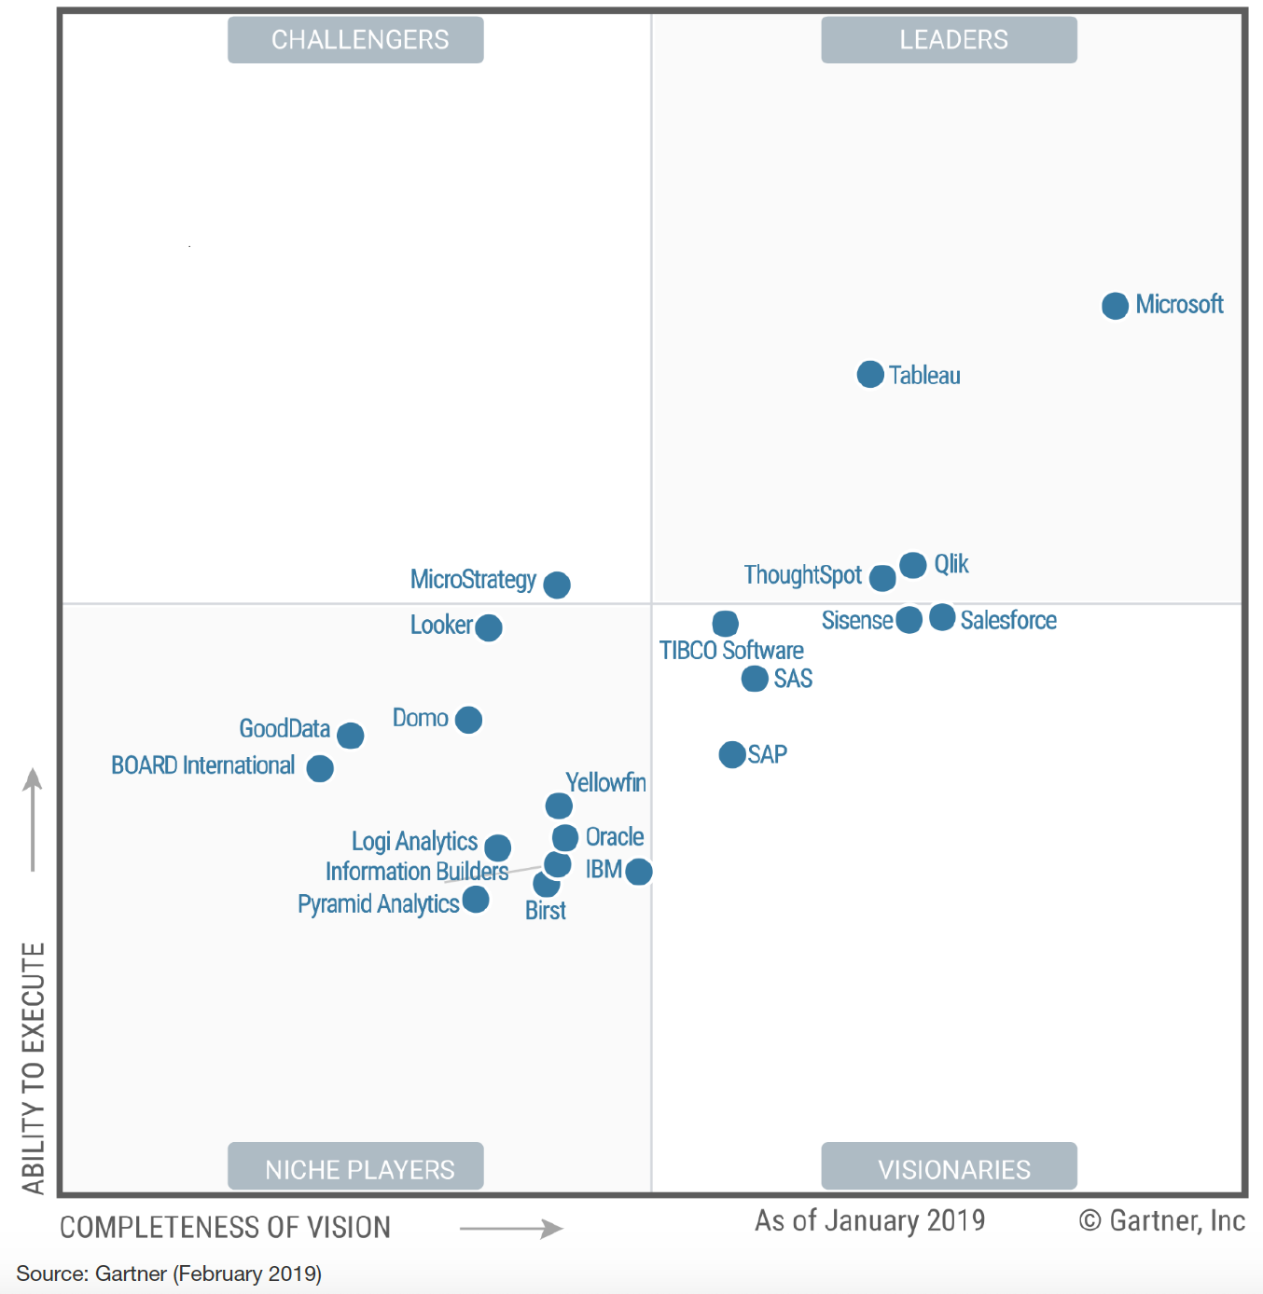

Slide 9
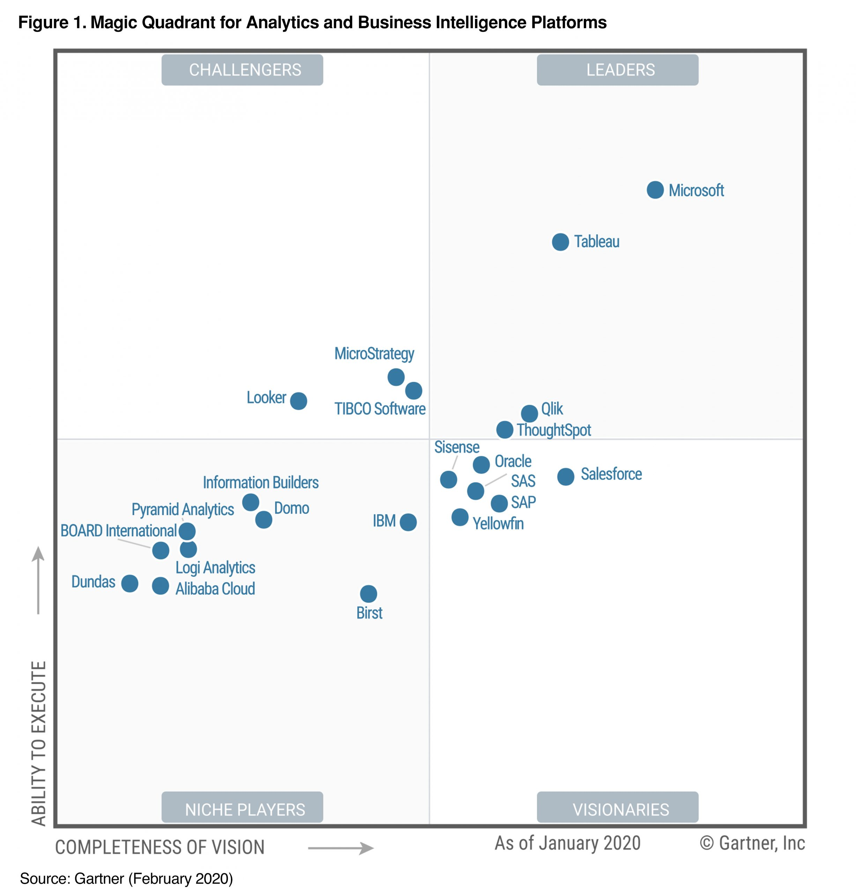

Slide 10
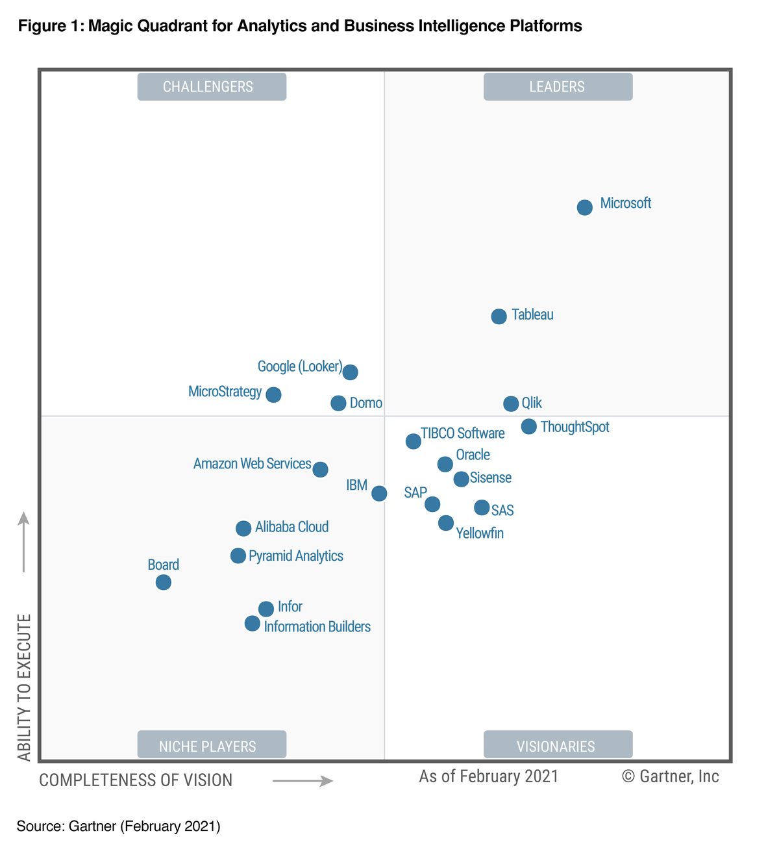

Slide 11
Microsoft Power BI

Slide 12
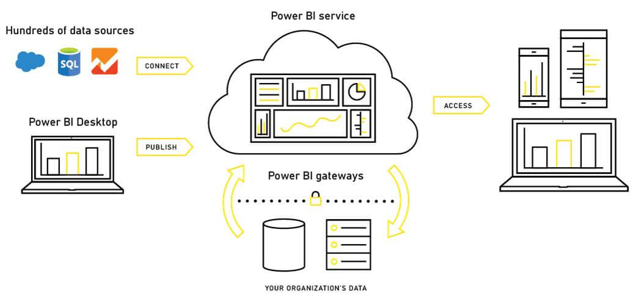
PBI Architecture

Slide 13
What is Power BI?
Tool that facilitate BI process

Slide 14
An Introduction

Slide 15
Power BI Flow
Extract
Transform
Load
Data Modelling
DAX
Report Building
Publish report
Dashboard Creation
Share and Collaborate
ETL (Power Query)
PBI Desktop
PBI Service

